Slide 1
PRESENTATION ON
INDIAN BANK ATM SYSTEM
Presented By: Nikita Gokharkar
Guide: Shalini Kumari
Java Full-Stack Development
Edubridge

Slide 2
CONTENTS
Introduction
Characteristics
Data Flow Diagram
Exsisting System
Proposed System
Software Requirements
Screenshots
Conclusion

Slide 3
INRODUCTION TO JAVA
Java
a programming language.
a development environment.
an application environmet.

Slide 4
CHARACTERISTIC
Java is almost entirely object oriented language.
It has a library of pre-defined objects or operations.
It is more platform independent, this make it great for web programming.
It is more secure.
It is simple.

Slide 5
ATM SYSTEM
This system manages and maintains the account records of the customers.
This project is build to provide the provisions for:
Checking the Balance.
Depositing the amount in the Checking Account or Saving Account.
Withdrawing the amount from the Checking Account or Saving Account.

Slide 6
FLOW DIAGRAM
Indian Bank ATM System
Insert Customer Number
No
Insert Pin Number
valid
Yes
Select Account
Checking Account
Saving Account
View Account
Deposite Funds
Withdraw Funds
Exit

Slide 7
EXSISTING SYSTEM
People have to physically visit the bank to check the details of their bank account.
It is difficult to manage every detail manually and also there is higher chance of human errors.
It is time consuming.

Slide 8
PROPOSED SYSTEM
Easy to use
Can be accessed from anywhere
Reduces manual work
Less errors

Slide 9
SOFTWARE REQUIREMENTS
Language - Java
IDE - Eclipse IDE

Slide 10
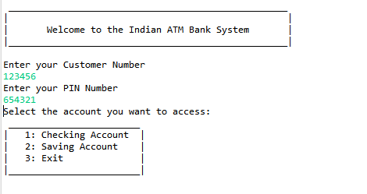
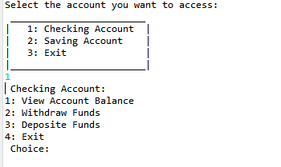
SCREENSHOTS
Enter the customer number
Enter the Pin Number
Enter the choice

Slide 11
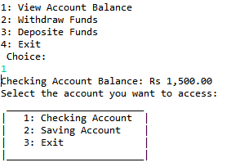
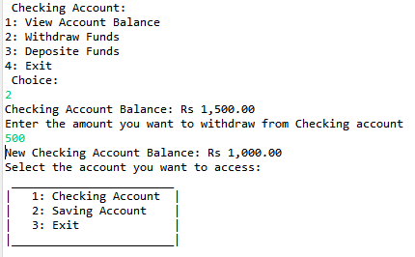
Display the current amount in the account
Withdraw money from the exsisting money from the account

Slide 12
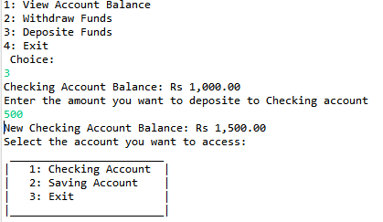
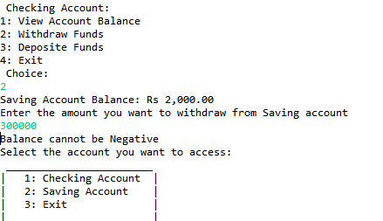
Withdraw amount cannot be less than the amount in the account
Depositing the money in the account

Slide 13
CONCLUSION
This system is build to maintaining and managing the details of customers bank accounts.

